Slide 1

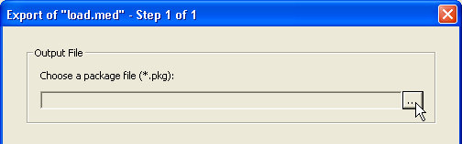
HAMILTON Software venus
Import, Export

Slide 2
Export a method
HAMILTON Software venus
Method export is used if you want to copy a method (and all files related to this method) to another computer.
If you use this function, a package file will be created. This package file contains all method relevant files used in the original method (such as libraries, labware, method and deck layout files).
It is also possible to send a package by email to share with others or to use a package file as backup

Slide 3
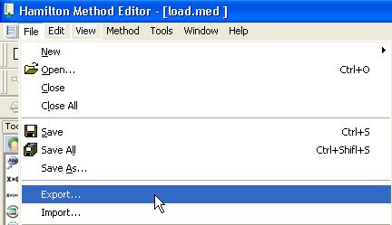
HAMILTON Software venus
Export a method
In method editor with your method open on list view
Click on FILE → EXPORT in the Method editor. Make sure the method to export is open

Slide 4
HAMILTON Software venus
Export a method
Click on … to browse

Slide 5
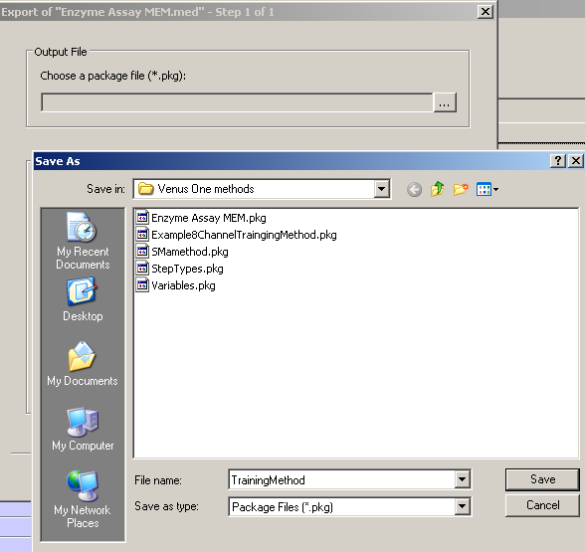
HAMILTON Software venus
Export a method
Type in the name of the package you want to create…
… and save

Slide 6
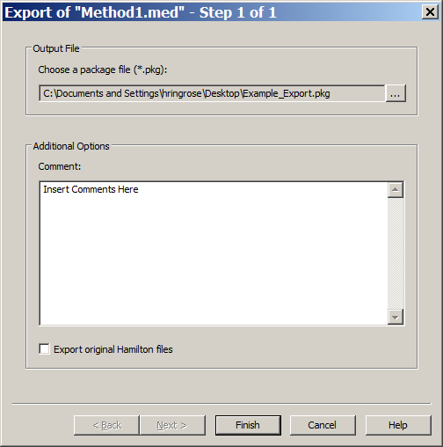
HAMILTON Software venus
Export a method
The selected path and package name appears
Additional comments can be added (Version, date, author, …)
Choose whether to export original files (in general, do not)

Slide 7
HAMILTON Software venus
Export a method
Then, start the creation of the package file

Slide 8
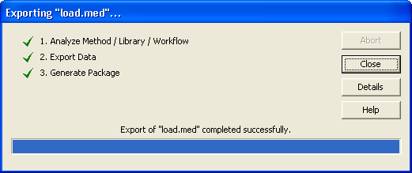
HAMILTON Software venus
Export a method
After successful package file creation, click on Close

Slide 9
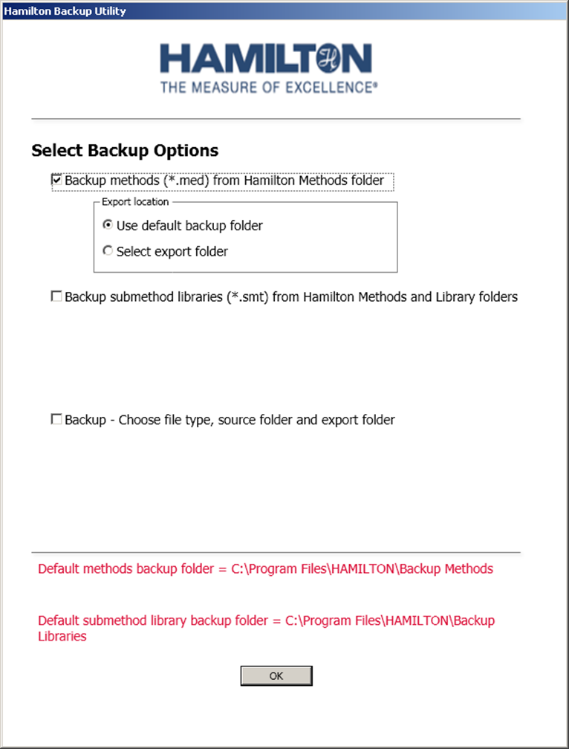
HAMILTON Software venus
Automated Export of Methods - Hamilton Backup Utility
Hamilton backup utility provided on training course USB stick – See Additional Info\Automated Backup folder
See Hamilton Backup Utility Guide.pdf for details on how to install and use
Addition Info folder also contains automated backup details for use with Windows XP

Slide 10
HAMILTON Software venus
Import a method
Method import is used to extract a package file on a computer.
If you use this function, a package file will be unpacked and all method relevant files plus added files will be stored on the target computer.
This will only work if the Hamilton VENUS software is installed on the target computer

Slide 11
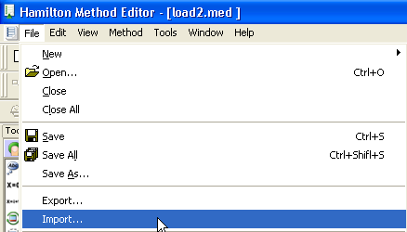
HAMILTON Software venus
Import a method
Click on File → Import in the Method editor

Slide 12
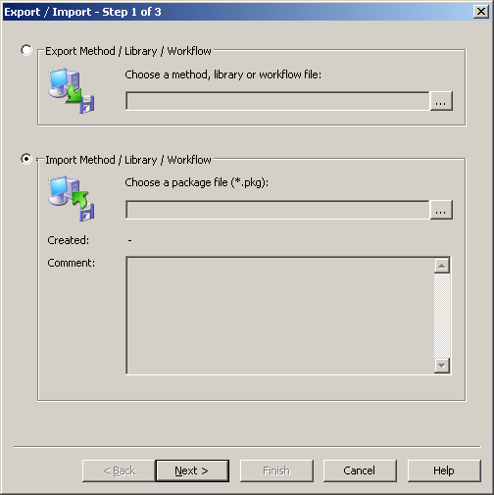
HAMILTON Software venus
Import a method
Click on … to browse to the package file

Slide 13
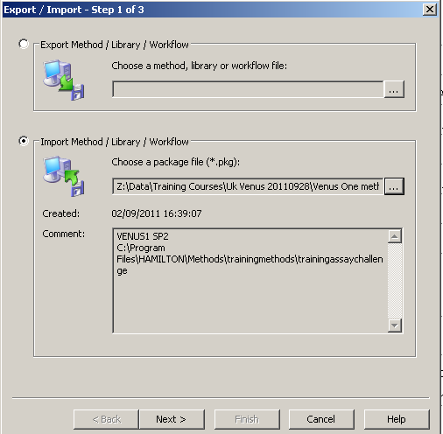
HAMILTON Software venus
Import a method
The selected package file and it‘s comments appear in the window
Click to continue

Slide 14
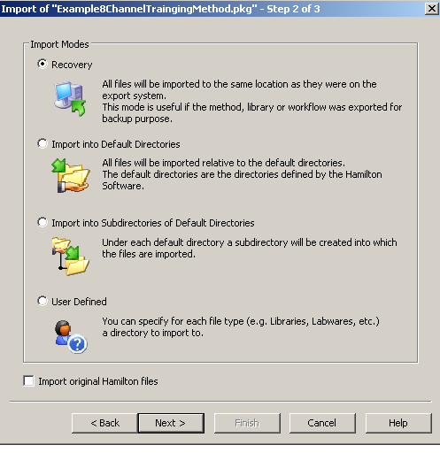
HAMILTON Software venus
Import a method
Decide where to store the data on the target computer. Read the description and select the appropriate location.

Slide 15
HAMILTON Software venus
Import a method
Recovery: All files will be imported to the same location as they
were on the export system.
Import into default directories: All files will be imported to the default directories.
Import into sub-directories of default directories: A sub-directory is created under each default directory. The files are copied into the sub-directory.
User Defined: The user can specify the paths for import

Slide 16
HAMILTON Software venus
Import a method
Click to continue

Slide 17
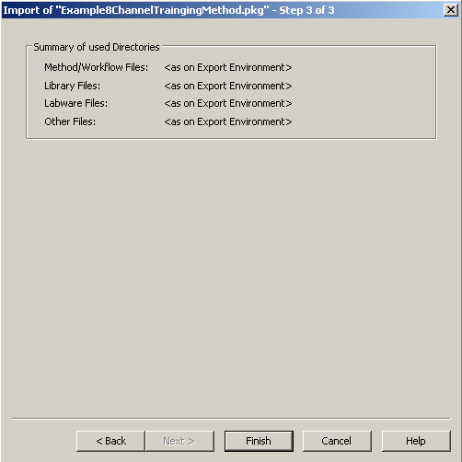
HAMILTON Software venus
Import a method
Your selection of target paths is displayed
Click to continue

Slide 18
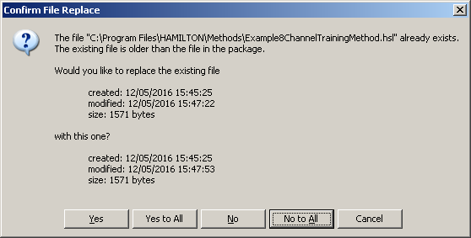
HAMILTON Software venus
Import a method
On import, Venus will compare date and time stamps of all files that are present both in the package and in the destination location.
If the time and date stamps are different you will see the following message
Compare time and date stamps for existing file and package file.
Click Yes to replace existing file or no as required
Think carefully if you want to update the file or not

Slide 19
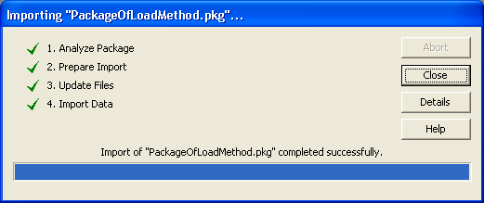
HAMILTON Software venus
Import a method
Click to continue

Slide 20
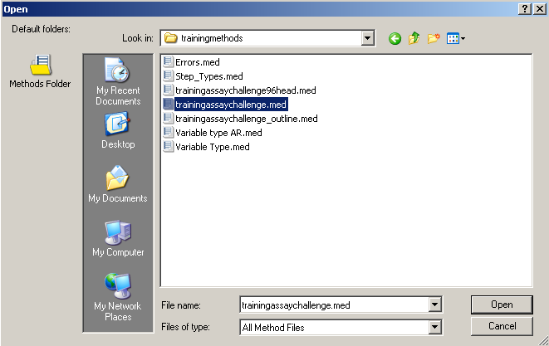
HAMILTON Software venus
Import a method
The imported method can now be opened and used

Slide 21
HAMILTON Software VENUS
Exercise
Please now export your method to the desktop to backup your days work
Notes:
21

